Slide 1
Fundamentals of Python:
From First Programs Through Data Structures
Chapter 10
Multithreading, Networks, and Client/Server Programming

Slide 2
Objectives
After completing this chapter, you will be able to:
Describe what threads do and how they are manipulated in an
application
Code an algorithm to run as a thread
Use conditions to solve a simple synchronization problem with threads
Fundamentals of Python: From First Programs Through Data Structures

Slide 3
Objectives (continued)
Use IP addresses, ports, and sockets to create a simple client/server application on a network
Decompose a server application with threads to handle client requests efficiently
Restructure existing applications for deployment as client/server applications on a network
Fundamentals of Python: From First Programs Through Data Structures

Slide 4
Threads and Processes
Time-sharing systems (late 1950s – early 1960s)
  Allowed several programs to run concurrently on a single computer
Multiprocessing systems (1980s)
  A single user running several programs at once
Networked/distributed systems (1980s –1990s)
  Processes began to be distributed across several CPUs linked by high-speed communication lines
Parallel systems
  Run a single program on several CPUs at once
Fundamentals of Python: From First Programs Through Data Structures

Slide 5
Threads
In Python, a thread is an object like any other in that it can hold data, be run with methods, be stored in data structures, and be passed as parameters to methods
A thread can also be executed as a process
  Before it can execute, a thread’s class must implement a run method
During its lifetime, a thread can be in various states
Fundamentals of Python: From First Programs Through Data Structures

Slide 6
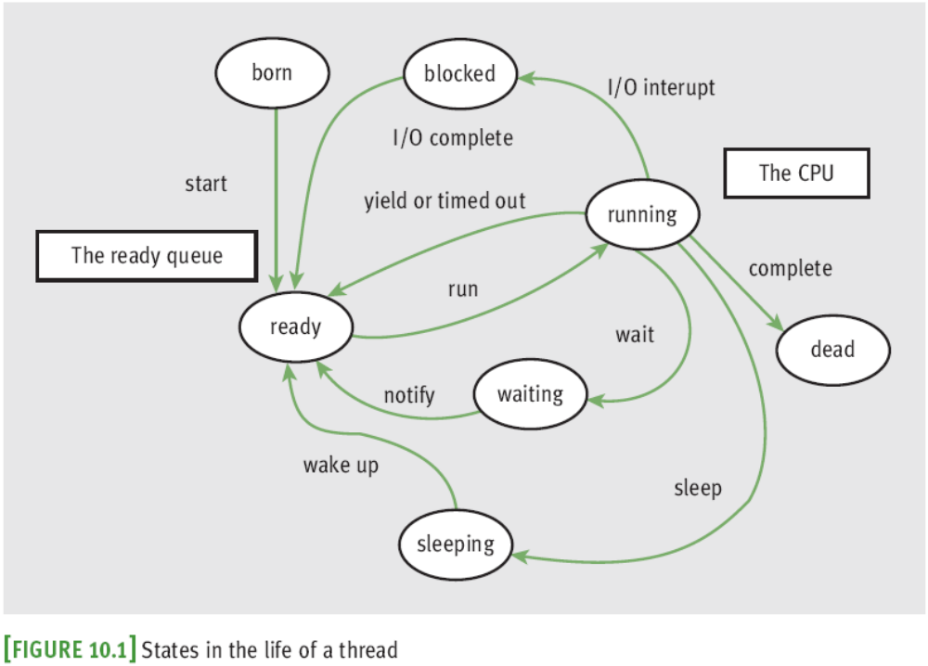
Threads (continued)
Fundamentals of Python: From First Programs Through Data Structures

Slide 7
Threads (continued)
A thread remains inactive until start method runs
  Thread is placed in the ready queue
  Newly started thread’s run method is also activated
A thread can lose access to the CPU:
  Time-out (process also known as time slicing)
  Sleep
  Block
  Wait
Process of saving/restoring a thread’s state is called a context switch
Fundamentals of Python: From First Programs Through Data Structures

Slide 8
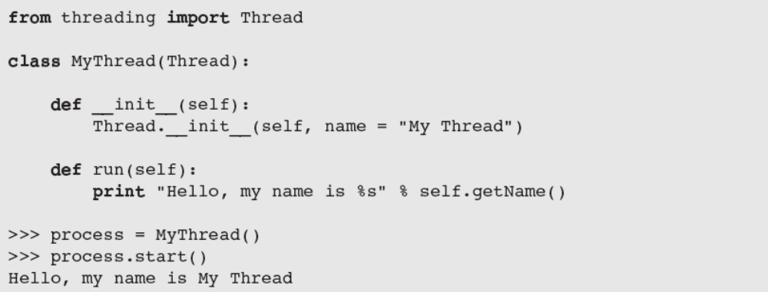
Threads (continued)
Most common way to create a thread is to define a class that extends the class threading.Thread
Fundamentals of Python: From First Programs Through Data Structures

Slide 9
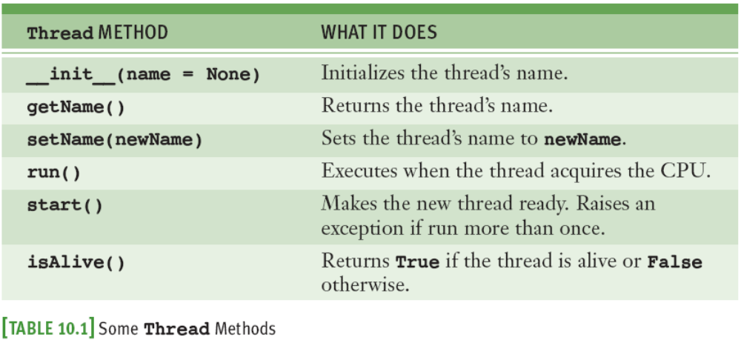
Threads (continued)
A thread’s run method is invoked automatically by start
Fundamentals of Python: From First Programs Through Data Structures

Slide 10
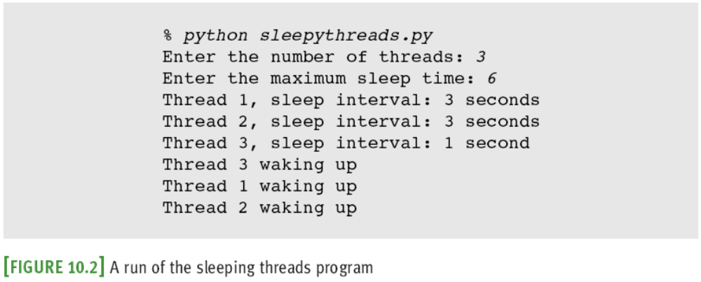
Sleeping Threads
The function time.sleep puts a thread to sleep for the specified number of seconds
Fundamentals of Python: From First Programs Through Data Structures

Slide 11
Producer, Consumer, and Synchronization
Threads that interact by sharing data are said to have a producer/consumer relationship
Example: an assembly line in a factory
  A producer must produce each item before a consumer consumes it
  Each item must be consumed before the producer produces the next item
  A consumer must consume each item just once
We will simulate a producer/consumer relationship:
  Will share a single data cell with an integer
Fundamentals of Python: From First Programs Through Data Structures

Slide 12
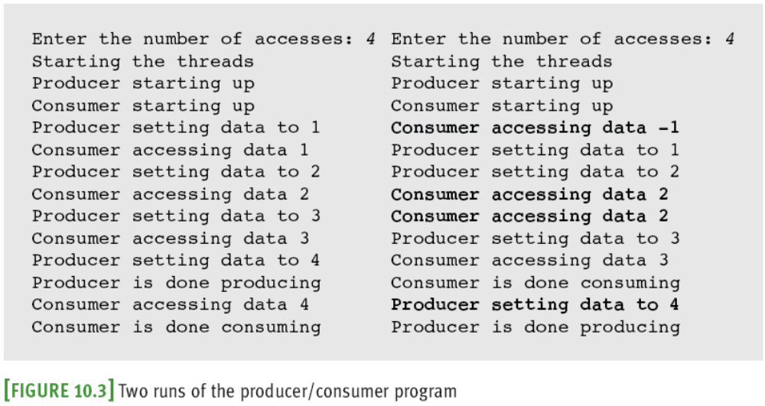
Producer, Consumer, and Synchronization (continued)
Threads sleep for random intervals
Fundamentals of Python: From First Programs Through Data Structures

Slide 13
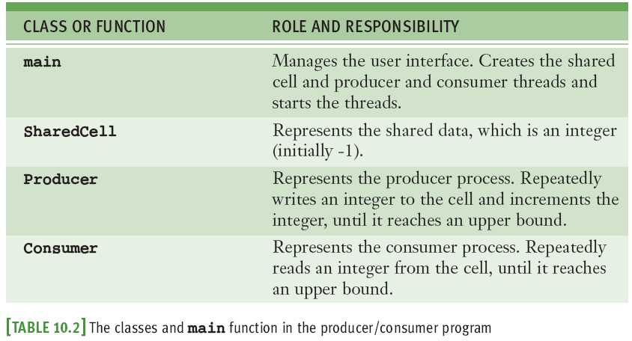
Producer, Consumer, and Synchronization (continued)
Fundamentals of Python: From First Programs Through Data Structures

Slide 14
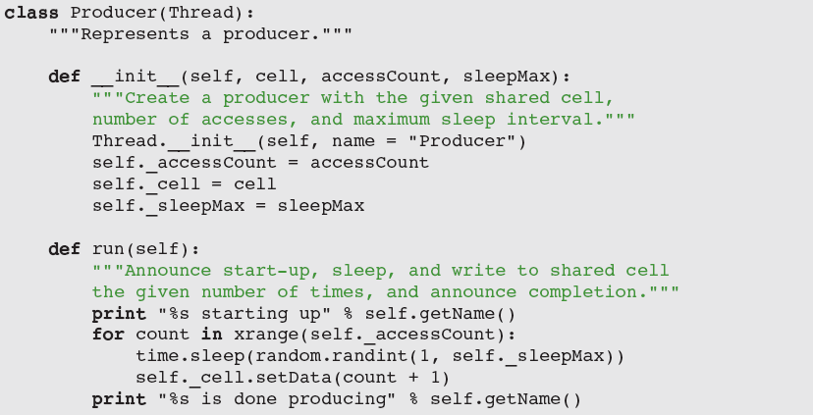
Producer, Consumer, and Synchronization (continued)
Fundamentals of Python: From First Programs Through Data Structures

Slide 15
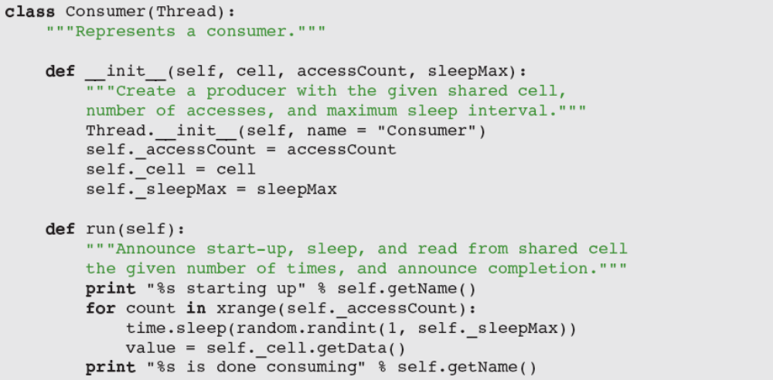
Producer, Consumer, and Synchronization (continued)
Fundamentals of Python: From First Programs Through Data Structures

Slide 16
Producer, Consumer, and Synchronization (continued)
Synchronization problems may arise:
  Consumer accesses the shared cell before the producer has written its first datum
  Producer then writes two consecutive data (1 and 2) before the consumer has accessed the cell again
  Consumer accesses data 2 twice
  Producer writes data 4 after consumer is finished
Solution: synchronize producer/consumer threads
  States of shared cell: writeable or not writeable
Fundamentals of Python: From First Programs Through Data Structures

Slide 17
Producer, Consumer, and Synchronization (continued)
Solution (continued):
  Add two instance variables to SharedCell: a Boolean flag (_writeable) and an instance of threading.Condition
A Condition maintains a lock on a resource
Pattern for accessing a resource with a lock:
  Run acquire on the condition.
  While it’s not OK to do the work
  Run wait on the condition.
  Do the work with the resource.
  Run notify on the condition.
  Run release on the condition.
Fundamentals of Python: From First Programs Through Data Structures

Slide 18
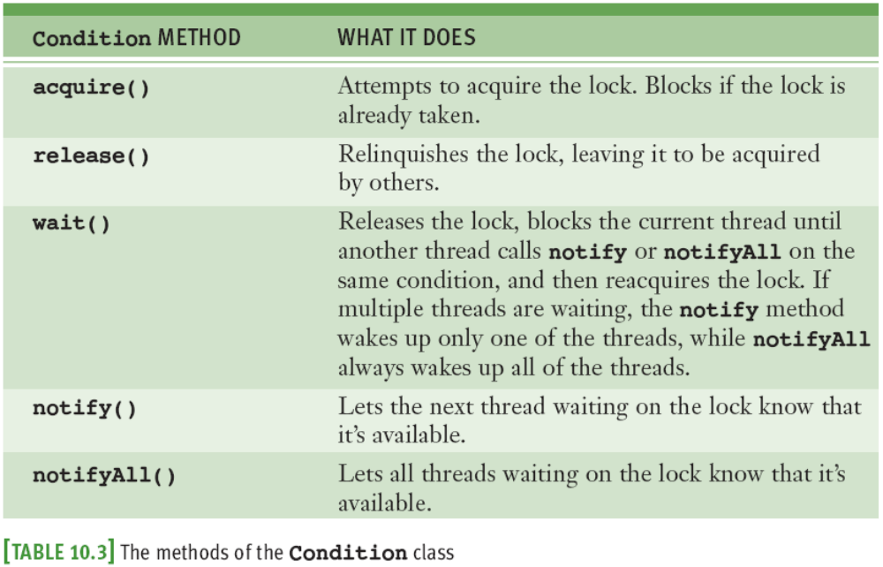
Producer, Consumer, and Synchronization (continued)
Fundamentals of Python: From First Programs Through Data Structures

Slide 19
Networks, Clients, and Servers
Clients and servers are applications or processes that can run locally on a single computer or remotely across a network of computers
The resources required for this type of application are:
  IP addresses
  Sockets
  Threads
Fundamentals of Python: From First Programs Through Data Structures

Slide 20
IP Addresses
A computer on a network has a unique identifier called an IP address (IP: Internet Protocol)
  Can be specified as an IP number
    Format: ddd.ddd.ddd.ddd (d is a digit)
    Example: 137.112.194.77
  Or, as an IP name
    Example: lambertk
Python’s socket module includes two functions that can look up these items of information
Fundamentals of Python: From First Programs Through Data Structures

Slide 21
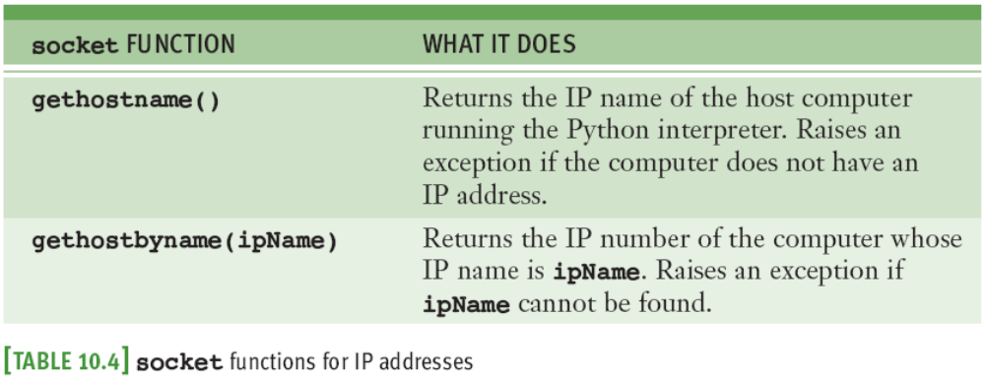
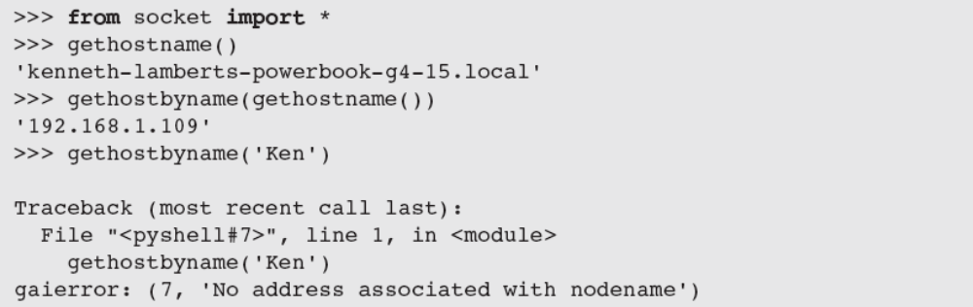
IP Addresses (continued)
May raise exceptions;
to avoid, embed in a
try-except statement
You may use ' localhost‘ (127.0.0.1) for testing
Fundamentals of Python: From First Programs Through Data Structures

Slide 22
Ports, Servers, and Clients
Clients connect to servers via ports
  Serve as a channel through which several clients can exchange data with the same server or with different servers
  Usually specified by numbers
  Some are dedicated to special servers or tasks
    Example: 13 for the day/time server or 80 for a Web server
Most computers also have hundreds or even thousands of free ports available for use by any network applications
Fundamentals of Python: From First Programs Through Data Structures

Slide 23
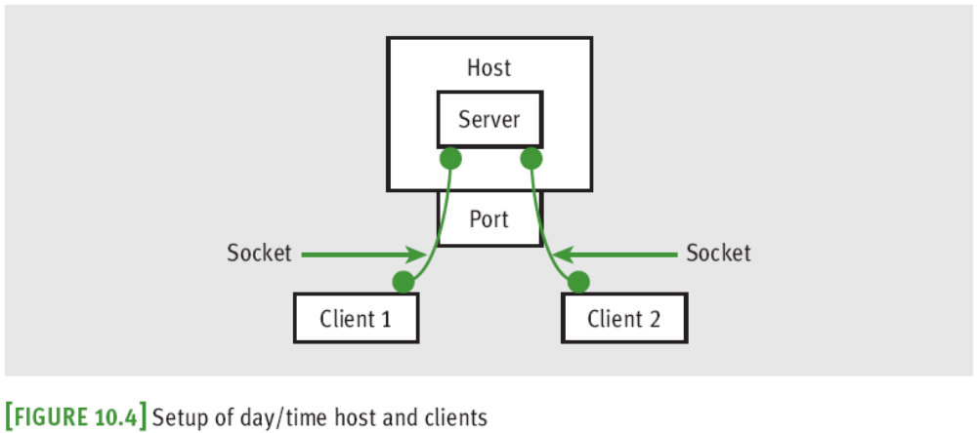
Sockets and a Day/Time Client Script
We’ll write a script that is a client to a server
Socket: object that serves as a communication link between a server process and a client process
  Can create/open several sockets on the same port
Fundamentals of Python: From First Programs Through Data Structures

Slide 24
A Day/Time Server Script
You can write a day/time server script in Python to handle requests from many clients
The basic sequence of operations for a simple day/time server script is:
  Create a socket and open it on port 5000 of the local host
  While true:
  Wait for a connection from a client
  When the connection is made, send the date to the client
Fundamentals of Python: From First Programs Through Data Structures

Slide 25
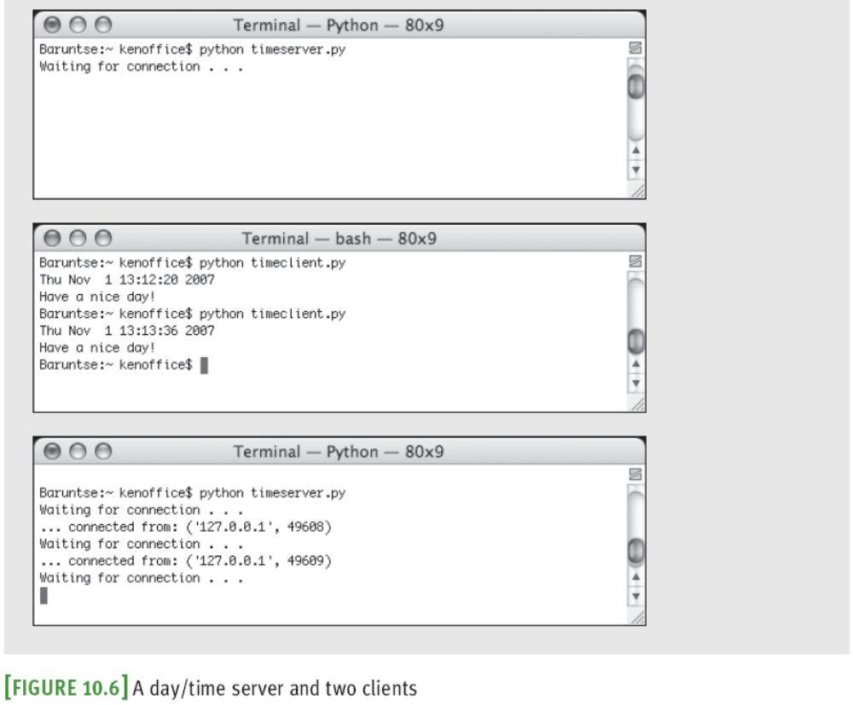
A Day/Time Server Script (continued)
Fundamentals of Python: From First Programs Through Data Structures

Slide 26
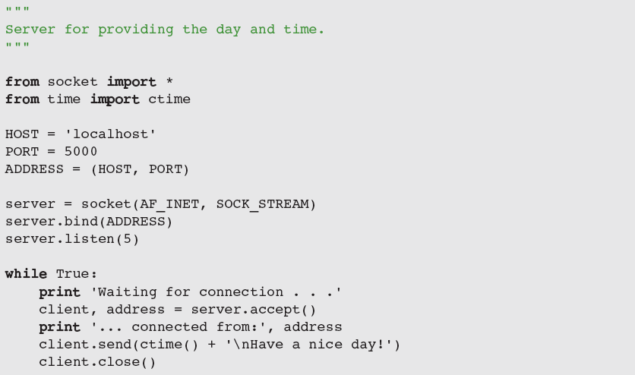
A Day/Time Server Script (continued)
Fundamentals of Python: From First Programs Through Data Structures

Slide 27
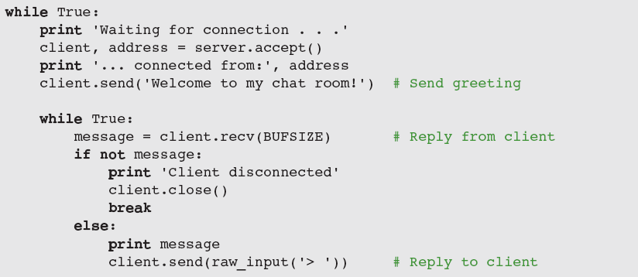
A Two-Way Chat Script
Server creates a socket and enters an infinite loop to accept/handle clients; when one connects, it sends a greeting, and enters loop to chat with client
Fundamentals of Python: From First Programs Through Data Structures

Slide 28
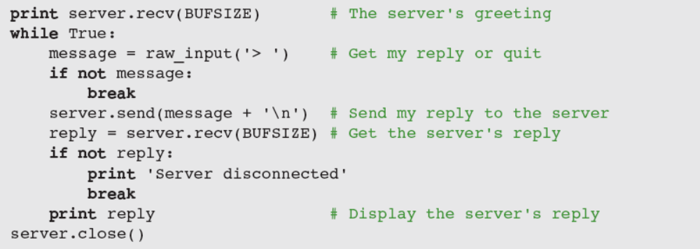
A Two-Way Chat Script (continued)
Client:
  Sets up a socket
  After connection, receives and displays greeting
  Then, enters a loop to chat with server
Fundamentals of Python: From First Programs Through Data Structures

Slide 29
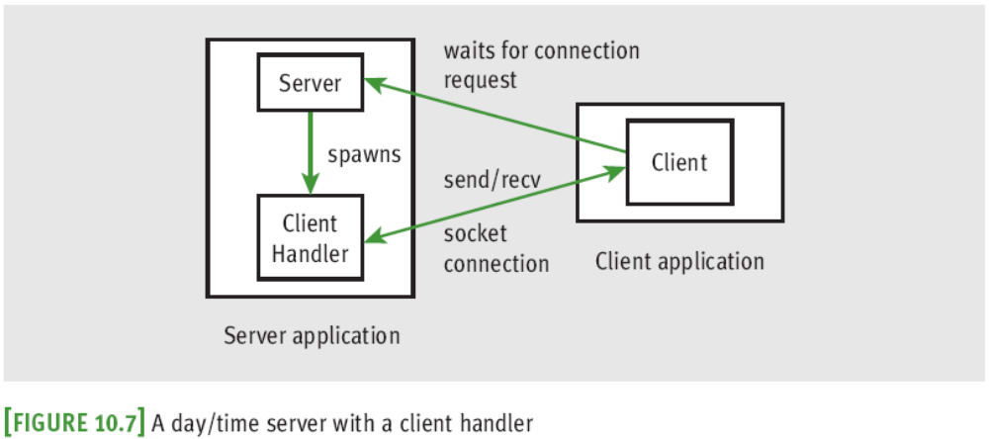
Handling Multiple Clients Concurrently
To solve the problem of giving many clients timely access to the server, we assign task of handling the client’s request a client-handler thread
Fundamentals of Python: From First Programs Through Data Structures

Slide 30
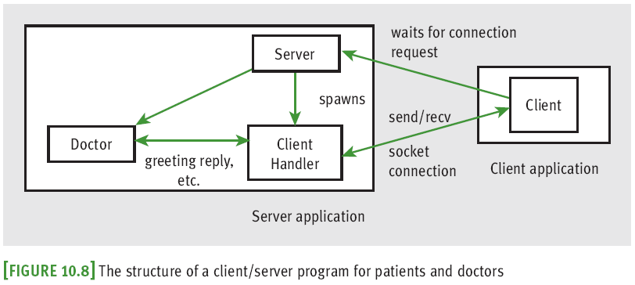
Setting Up Conversations for Others
How can we support multiple two-way chats?
Fundamentals of Python: From First Programs Through Data Structures

Slide 31
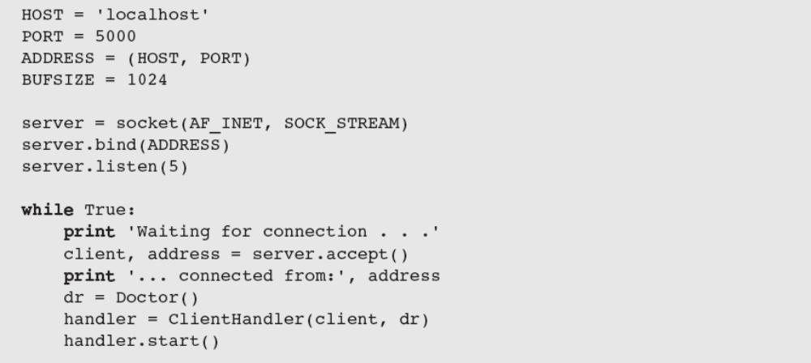
Setting Up Conversations for Others (continued)
Fundamentals of Python: From First Programs Through Data Structures

Slide 32
Case Study: A Multi-Client Chat Room
Request:
  Write a program that supports an online chat room
Analysis:
  When a client connects, sever sends a record of conversation so far in the following format:
    <day/time> <user name>
    <message>
Fundamentals of Python: From First Programs Through Data Structures

Slide 33
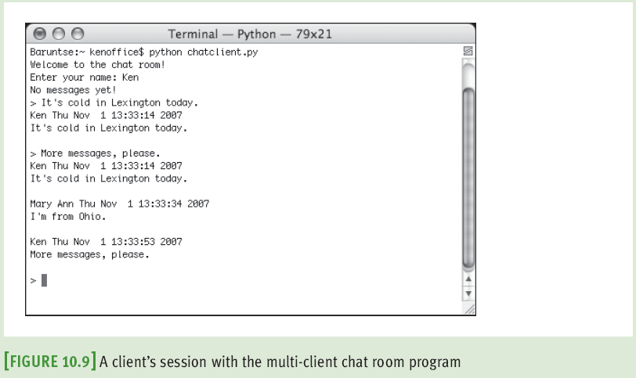
Case Study: A Multi-Client Chat Room (continued)
Fundamentals of Python: From First Programs Through Data Structures

Slide 34
Case Study: A Multi-Client Chat Room (continued)
Design:
  Program’s structure and behavior are similar to those of the online therapy server described earlier
  However, instead of communicating with a single autonomous software agent, a client communicates with the other clients
    Share a common record/transcript of the conversation
Fundamentals of Python: From First Programs Through Data Structures

Slide 35
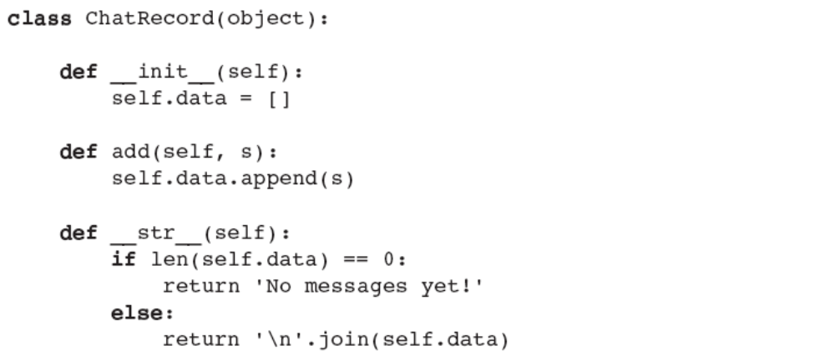
Case Study: A Multi-Client Chat Room (continued)
Implementation (Coding):
…
…
Fundamentals of Python: From First Programs Through Data Structures

Slide 36
Summary
Threads allow the work of a single program to be distributed among several computational processes
  States: born, ready, executing, sleeping, and waiting
After a thread is started, it goes to the end of the ready queue to be scheduled for a turn in the CPU
A thread may give up CPU when timed out, sleeps, waits on a condition, or finishes its run method
When a thread wakes up, is timed out, or is notified that it can stop waiting, it returns to the rear of the ready queue
Fundamentals of Python: From First Programs Through Data Structures

Slide 37
Summary (continued)
Thread synchronization problems can occur when two or more threads share data
Each computer on a network has a unique IP address that allows other computers to locate it
Servers and clients can communicate on a network by means of sockets
Clients and servers communicate by sending and receiving strings through their socket connections
A server can handle several clients concurrently by assigning each client request to a separate handler thread
Fundamentals of Python: From First Programs Through Data Structures

